Slide 1



Joint User and Receive Antenna Selection Algorithms for MU-MIMO Systems with Reduced Complexity
Project ID:21010
Student1:KabyashreeTripathy
Roll No: 201711588
BPUTRegn.No:1701202012
Student 2: Navneet Nipu
Roll No: 201710518
BPUT Regn. No:1701202158
By
Under the guidance of
Mr. Swadhin Mishra
Notes:
B-TECH PROJECT MID-SEM PRESENTATION 2011
BY KHUSHBU KHAN & ISAN SAHOO

Slide 2
Contents
Aims/Objectives
Introduction
System Model
JURAS Scheme for MU-MIMO
Suboptimal Algorithms
Work done
Future Work
Conclusions
References
Notes:
B-TECH PROJECT MID-SEM PRESENTATION 2011
BY KHUSHBU KHAN & ISAN SAHOO
2

Slide 3
Aims/Objectives
The aim is to show that a joint user and receive antenna selection (JURAS) scheme potentially provides significant gain over a user selection (US) scheme.
Two sub-optimal joint user and antenna selection algorithms with dynamic data stream allocation are also going to analyzed.

Slide 4
Introduction
MU-MIMO schemes have recently attracted attention due to their capability of offering significant gain in system capacity.
When users are equipped with multiple antennas, joint user and receive antenna selection may be performed and it potentially provide superior performance.
There are some techniques which provide theoretical sum capacity are DPC (Dirty Paper Coding) ,ZF (Zero Forcing), BD (Block Diagonalization) but they suffer due to high complexity (exhaustive algorithms).

Slide 5
Introduction
Hence joint user and receive antenna selection (JURAS) is used to achieve high sum capacity at high SNR.
Here two sub optimal algorithms are used to provide near theoretical sum capacity having reduced complexity.
These suboptimal algorithms will find the best combination of user and their receive antennas which will provide maximum possible data rates or sum capacity thereby increasing the data transfer rates.
Although they are suboptimal but they are very useful when number of receive antennas and users increase.

Slide 6
System Model
W₁
W*₁ H*₁
S₁
.
.
.
USER1
L₁ data
streams
N_{t}
S₁
H₁
Y₁
.
.
.
.
.
.
.
.
.
.
.
.
.
.
.
.
.
.
.
.
.
.
.
.
.
.
.
.
.
.
.
.
.
.
.
W_{k}
+
.
.
.
Available:N_{r,1}
Active:M₁
S_{k}
L_{k} data
streams
H_{k}
W*_{k} H*_{k}
.
.
.
USER K
S_{k}
Y_{k}
Adjust precoding matrices
Adjust number of data sreams
Available:N_{r,k}
Active:M_{k}
User Scheduling and precoding design

Slide 7
System Model
The system model consists of a single cell downlink MU MIMO network.
The BASE STATION has N_{t} number of transmitting antennas whereas there are K users having N_{r} receiving antennas with them where M_{k} receiving antennas will be active at a time for a particular user where M_{k} <= Nr .
Our objective function i.e. sum capacity is dependent on the SLNR based precoding matrix which has been given in next slides.
We will assume equal power per data stream power scheme while calculating the SINR for the system.

Slide 8

System Model
The received signal at the mobile station is given as,
$${ y}_{j}=H_{j}W_{j}s_{j}+H_{j}\sum_{k∈U_{i}k≠j}{ }W_{k}s_{k}+v_{j}$$
Received signal
White zero mean complex gaussian noise
Desired signal
Interfering undesired signals

Slide 9
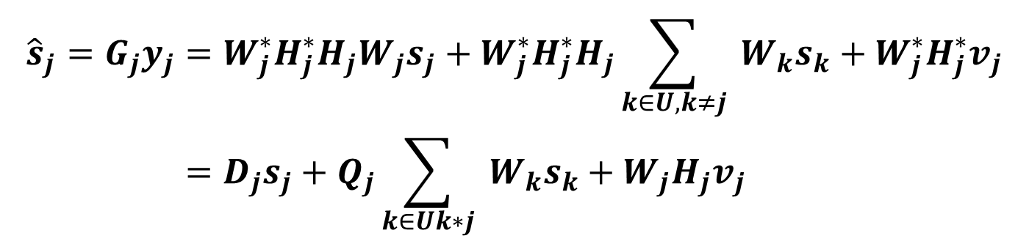

System Model
For SLNR based precoding matrix will be,the precoding matrix is given by,
${ W}_{j}^{o}=ρ⋅{ \text{eigvec} }_{L_{j}}\left\{H_{j}^{∗}H_{j},\left(M_{j}σ_{j}^{2}/E_{j}\right)I+{\tilde{H}}_{j}^{∗}{\tilde{H}}_{j}\right\}\left(N_{t}×L_{j}\right)$
After passing through matched filter in the receiver side, the signal becomes,
$$\begin{aligned}{\hat{s}}_{j}=G_{j}y_{j}&=W_{j}^{∗}H_{j}^{∗}H_{j}W_{j}s_{j}+W_{j}^{∗}H_{j}^{∗}H_{j}\sum_{k∈U,k≠j}{ }W_{k}s_{k}+W_{j}^{∗}H_{j}^{∗}v_{j} \\ &=D_{j}s_{j}+Q_{j}\sum_{k∈Uk∗j}{ }W_{k}s_{k}+W_{j}H_{j}v_{j}\end{aligned}$$

Slide 10
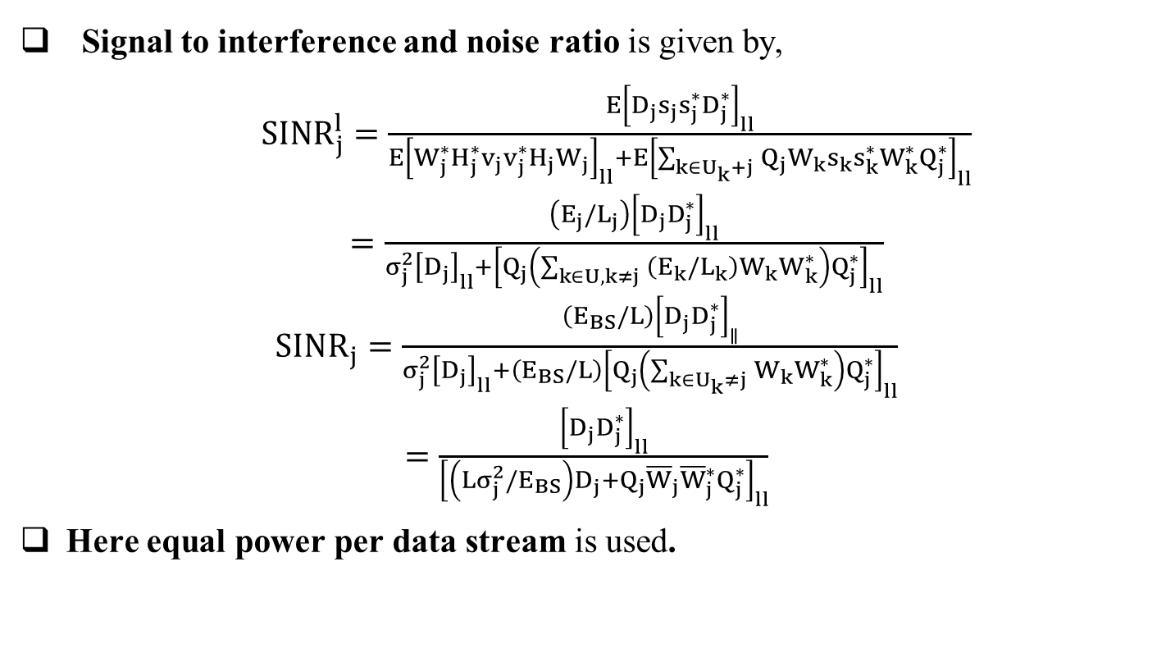
System Model
Signal to interference and noise ratio is given by,
$\begin{aligned}{SINR}_{j}^{l}=\frac{E{\left[D_{j}s_{j}s_{j}^{∗}D_{j}^{∗}\right]}_{ll}}{E{\left[W_{j}^{∗}H_{j}^{∗}v_{j}v_{j}^{∗}H_{j}W_{j}\right]}_{ll}+E{\left[\sum_{k∈U_{k}+j}{ }Q_{j}W_{k}s_{k}s_{k}^{∗}W_{k}^{∗}Q_{j}^{∗}\right]}_{ll}} \\ =\frac{\left(E_{j}/L_{j}\right){\left[D_{j}D_{j}^{∗}\right]}_{ll}}{σ_{j}^{2}{\left[D_{j}\right]}_{ll}+{\left[Q_{j}\left(\sum_{k∈U,k≠j}{ }\left(E_{k}/L_{k}\right)W_{k}W_{k}^{∗}\right)Q_{j}^{∗}\right]}_{ll}}\end{aligned}$ $\begin{aligned}{SINR}_{j}=\frac{\left(E_{BS}/L\right){\left[D_{j}D_{j}^{∗}\right]}_{∥}}{σ_{j}^{2}{\left[D_{j}\right]}_{ll}+\left(E_{BS}/L\right){\left[Q_{j}\left(\sum_{k∈U_{k}≠j}{ }W_{k}W_{k}^{∗}\right)Q_{j}^{∗}\right]}_{ll}} \\ =\frac{{\left[D_{j}D_{j}^{∗}\right]}_{ll}}{{\left[\left(Lσ_{j}^{2}/E_{BS}\right)D_{j}+Q_{j}{\overline{W}}_{j}{\overline{W}}_{j}^{∗}Q_{j}^{∗}\right]}_{ll}}\end{aligned}$
Here equal power per data stream is used.

Slide 11
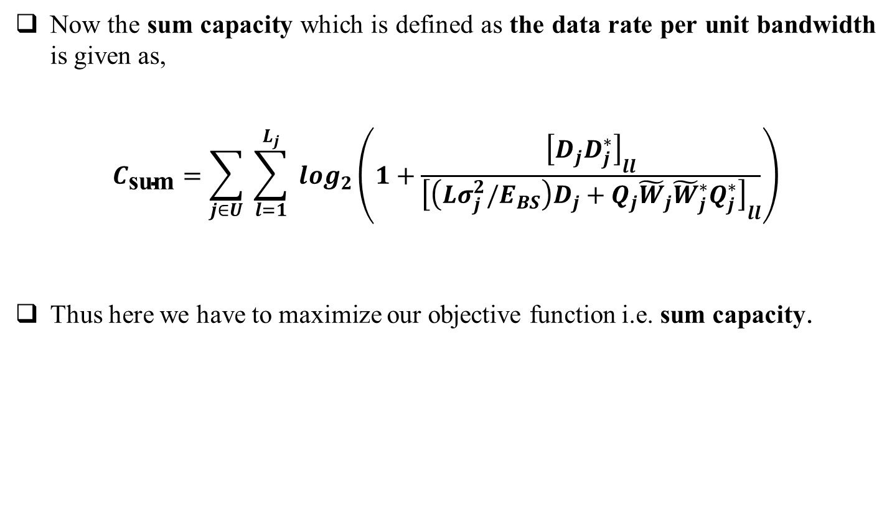
System Model
Now the sum capacity which is defined as the data rate per unit bandwidth is given as,
$$C_{\text{sum}}=\sum_{j∈U}{ }\sum_{l=1}^{L_{j}}{ }\log_{2}\left(1+\frac{{\left[D_{j}D_{j}^{∗}\right]}_{ll}}{{\left[\left(Lσ_{j}^{2}/E_{BS}\right)D_{j}+Q_{j}{\tilde{W}}_{j}{\tilde{W}}_{j}^{∗}Q_{j}^{∗}\right]}_{ll}}\right)$$
Thus here we have to maximize our objective function i.e. sum capacity.

Slide 12
JURAS Scheme for MU-MIMO
JURAS means the joint user and receive antenna selection scheme which is being implemented in this project using two suboptimal algorithms.
Suboptimal algorithm-1 works by updating the user’s precoding matrices and evaluate sum capacity(complexity is somewhat more).
Suboptimal algorithm-2 works by considering each receiving antenna as a single user during user selection process and then computes the precoding matrices used for data transmission (complexity is reduced ) .

Slide 13
Suboptimal Algorithms
Suboptimal algorithm 1
This suboptimal algorithm can be divided into two phases.The first phase extends the ideas of the capacity-based iterative user selection algorithm.
It selects a receive antenna with the highest capacity. Then, from the remaining unselected antennas, it finds the next receive antenna providing the largest sum capacity.
This phase terminates when the sum capacity would reduce as a result of adding one more receive antenna (equivalent to one more data stream).

Slide 14
Suboptimal Algorithms
In the second phase, the algorithm researches the remaining unselected antennas of the selected users without increasing the number of allocated data streams.
The algorithm terminates when no extra sum capacity is achieved by the receive beamforming.

Slide 15
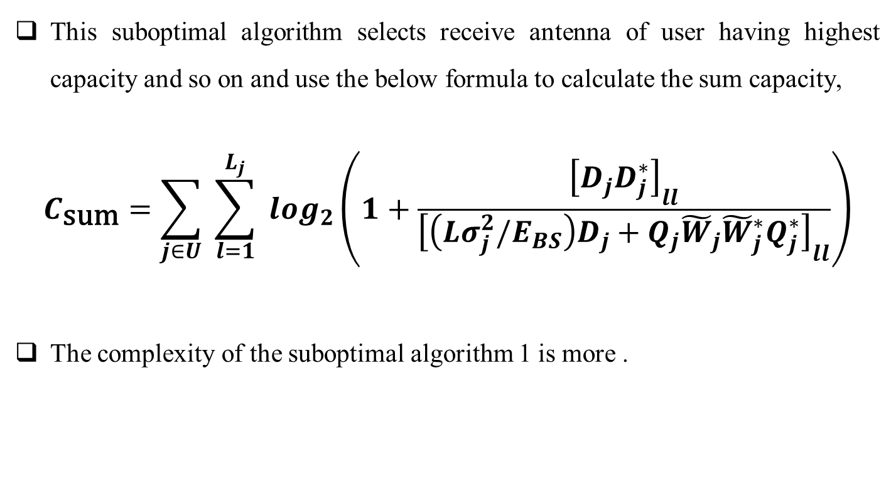
Suboptimal Algorithms
This suboptimal algorithm selects receive antenna of user having highest capacity and so on and use the below formula to calculate the sum capacity,
$$C_{\text{sum}}=\sum_{j∈U}{ }\sum_{l=1}^{L_{j}}{ }\log_{2}\left(1+\frac{{\left[D_{j}D_{j}^{∗}\right]}_{ll}}{{\left[\left(Lσ_{j}^{2}/E_{BS}\right)D_{j}+Q_{j}{\tilde{W}}_{j}{\tilde{W}}_{j}^{∗}Q_{j}^{∗}\right]}_{ll}}\right)$$
The complexity of the suboptimal algorithm 1 is more .

Slide 16
Suboptimal Algorithms
SA-1 PSEUDOCODE

Slide 17
Suboptimal Algorithms

Slide 18

Suboptimal Algorithms
elseif phase $=1$
$ℛ=$ remaining antennas of users in $u,$
not been selected in $δ$ phase $=2$
Else
flag $=0$
End
End
Output: $𝓢,𝓤,l$

Slide 19
Suboptimal Algorithms
Suboptimal algorithm 2
It is seen that the main computational burden of SA1 focuses on updating users’ precoding matrices and evaluating the sum capacity.
Thus, the algorithm is only required to compute the beamforming vector of the candidate antenna without updating the precoding matrices of the selected ones.
Treating each receive antenna as an individual user provides more robustness to the errors from outdated precoding matrices than considering multiple antennas at each user.

Slide 20
Suboptimal Algorithms
By treating each antenna as a separate user, no receive beamforming can be exploited. Thus, procedures in the second phase are excluded from SA2 and the number of data streams is always equal to the number of selected antennas.
SA2 becomes similar to the user selection algorithm , except that the sum power constraint is considered in the algorithm proposed here.

Slide 21
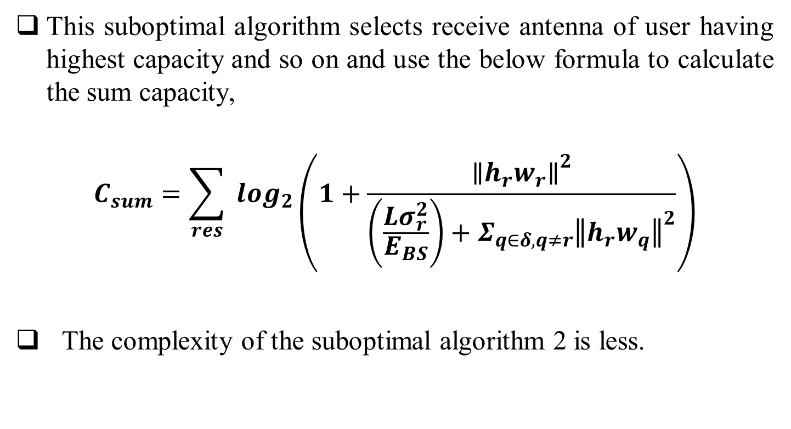
Suboptimal Algorithms
This suboptimal algorithm selects receive antenna of user having highest capacity and so on and use the below formula to calculate the sum capacity,
$$C_{sum}=\sum_{res}{ }\log_{2}\left(1+\frac{{∥h_{r}w_{r}∥}^{2}}{\left(\frac{Lσ_{r}^{2}}{E_{BS}}\right)+Σ_{q∈δ,q≠r}{∥h_{r}w_{q}∥}^{2}}\right)$$
The complexity of the suboptimal algorithm 2 is less.

Slide 22
Suboptimal Algorithms
SA-2 PSEUDOCODE

Slide 23
Suboptimal Algorithms

Slide 24
Suboptimal Algorithms
Below is the code to generate the independent complex gaussian channel matrix in matlab where the mean is zero and variance is unity.
n_r=3; % number of receiving antennas
n_t=5; % number of transmitting antennas
K=5; % number of users
Hr=sqrt(1/2)*randn(n_r,n_t,k) + sqrt(1/2)*i1*randn(n_r,n_t,k);
Here we have taken randn function so as to generate the random numbers having mean=0 and variance=1.
This will generate k channel matrices having n_r rows and n_t columns.

Slide 25
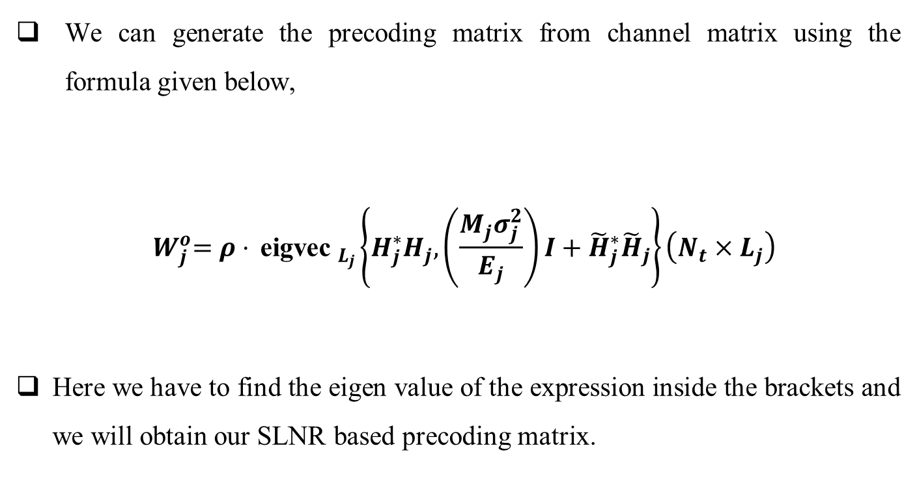
Suboptimal Algorithms
We can generate the precoding matrix from channel matrix using the formula given below,
$${ W}_{j}^{o}=ρ⋅{ \text{eigvec} }_{L_{j}}\left\{H_{j}^{∗}H_{j},\left(\frac{M_{j}σ_{j}^{2}}{E_{j}}\right)I+{\tilde{H}}_{j}^{∗}{\tilde{H}}_{j}\right\}\left(N_{t}×L_{j}\right)$$
Here we have to find the eigen value of the expression inside the brackets and we will obtain our SLNR based precoding matrix.

Slide 26
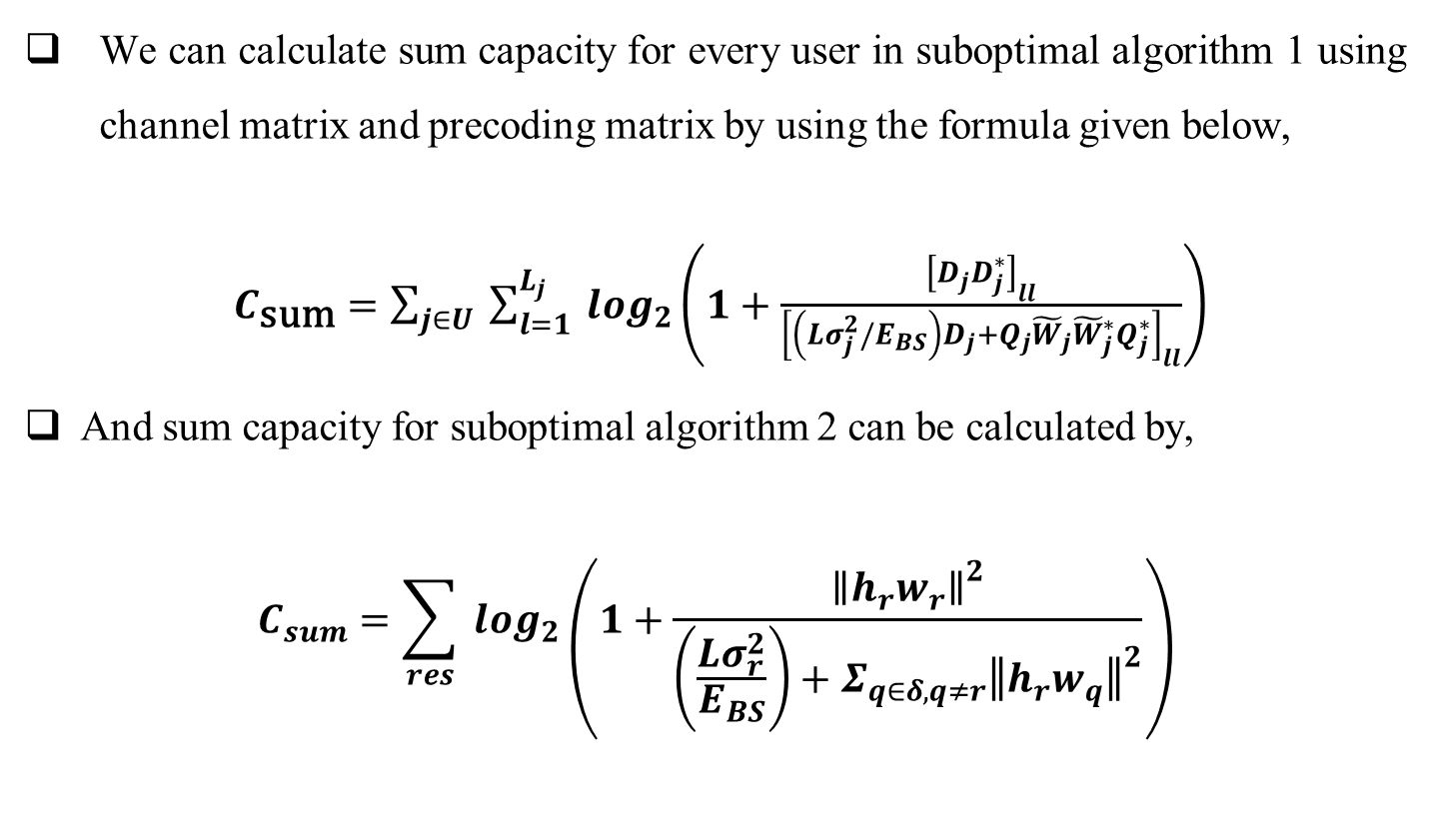
Suboptimal Algorithms
We can calculate sum capacity for every user in suboptimal algorithm 1 using channel matrix and precoding matrix by using the formula given below,
$C_{\text{sum}}=\sum_{j∈U}{ }\sum_{l=1}^{L_{j}}{ }\log_{2}\left(1+\frac{{\left[D_{j}D_{j}^{∗}\right]}_{ll}}{{\left[\left(Lσ_{j}^{2}/E_{BS}\right)D_{j}+Q_{j}{\tilde{W}}_{j}{\tilde{W}}_{j}^{∗}Q_{j}^{∗}\right]}_{ll}}\right)$
And sum capacity for suboptimal algorithm 2 can be calculated by,
$$C_{sum}=\sum_{res}{ }\log_{2}\left(1+\frac{{∥h_{r}w_{r}∥}^{2}}{\left(\frac{Lσ_{r}^{2}}{E_{BS}}\right)+Σ_{q∈δ,q≠r}{∥h_{r}w_{q}∥}^{2}}\right)$$

Slide 27
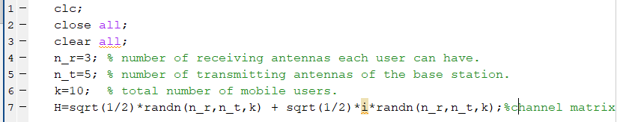
Work done
In this session we have generated the channel matrix using matlab and the output is shown in the next page.
we have generated the zero mean and unity variance complex gaussian channel matrix which will be used to find the precoding matrices for the suboptimal algorithms and the sum capacity using the given formulae.
Below is the matlab code for channel matrix.

Slide 28
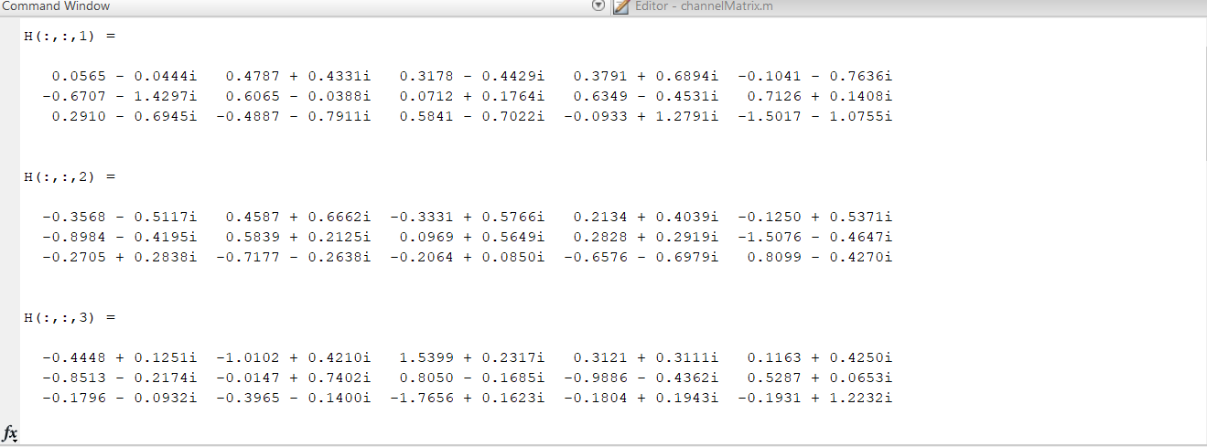
Work done
Channel matrix matlab code output

Slide 29
Future Work
Till now we have designed the algorithm for the two suboptimal algorithms and we have generated the complex gaussian zero mean and unity variance channel matrix which will be used to calculate the precoding matrix of the system and then sum capacity which is our objective function.
In the next session we have to implement the algorithms in matlab and calculate the sum capacity and carryout our simulation results so as to analyze every corner of our suboptimal algorithms whether they provide us satisfactory results or not.

Slide 30
Conclusions
The JURAS scheme enhances the performance gain.
The JURAS scheme performance gain is significant at high SNR.
The two JURAS suboptimal algorithms reduced the complexity of computation.

Slide 31
Reference
M. Sadek, A. Tarighat, and A. H. Sayed, "A Leakage-Based Precoding Scheme for Downlink Multi-User MIMO Channels," IEEE Transactions on Wireless Communications, vol. 6, no. 5, May 2007.
M. Sadek, A. Tarighat, and A. H. Sayed, "Active Antenna Selection in Multiuser MIMO Communications," IEEE Transactions on Signal Processing, vol. 55, no. 4, pp. 1498 - 1510, Apr 2007.
M. Costa, "Writing on Dirty Paper," IEEE Transactions on Information Theory, vol. 29, no. 3, pp. 439-441, May 1983.

Slide 32
Reference
G. Caire and S. S. (Shitz), "On the Achievable Throughput of a Multiantenna Gaussian Broadcast Channel," IEEE Transactions on Information Theory, vol. 49, no. 7, pp. 1691-1706, Jul 2003.
Q. H. Spencer, A. L. Swindlehurst, and M. Haardt, "Zero-Forcing methods for Downlink Spatial Multiplexing in Multiuser MIMO channels," IEEE Transactions on Signal Processing, vol. 52, no. 2, pp. 461-471, Feb 2004.

Slide 33
Thank You

